Slide 1
OPERATING SYSTEMS (CS F372) Synchronization
Barsha Mitra
CSIS Dept., BITS Pilani, Hyderabad Campus

Slide 2
Background
Processes can execute concurrently
May be interrupted at any time
Concurrent access to shared data may result in data inconsistency
Maintaining data consistency requires mechanisms to ensure the orderly execution of cooperating processes
Consider the Producer-Consumer problem

Slide 3
Producer - Consumer
while (true) { /* produce an item in next produced*/
while (counter == BUFFER_SIZE) ;
/* do nothing */
buffer[in] = next_produced;
in = (in + 1) % BUFFER_SIZE;
counter++;
}
while (true) {
while (counter == 0)
; /* do nothing */
next_consumed = buffer[out];
out = (out + 1) % BUFFER_SIZE;
counter--;
/* consume the item in next consumed */
}
counter++ implementation
register1 = counter register1 = register1 + 1 counter = register1
counter– implementation
register2 = counter register2 = register2 - 1 counter = register2
T0 | producer executes register1 = counter | register1 = 5
T1 | producer executes register1 = register1 + 1 | register1 = 6
T2 | consumer executes register2 = counter | register2 = 5
T3 | consumer executes register2 = register2 – 1 | register2 = 4
T4 | producer executes counter = register1 | counter = 6
T5 | consumer executes counter = register2 | counter = 4
RACE CONDITION

Slide 4
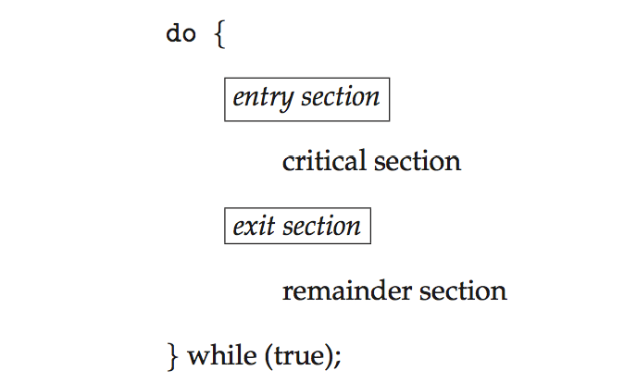
Critical Section Problem
Consider system of n processes {p₀ , p₁, … p_{n-1}}
Each process has critical section segment of code
Process may be changing common variables, updating table, writing to file, etc.
When one process is in critical section, no other may be in its critical section
Critical section problem is to design protocol to solve this
entry section
exit section
remainder section

Slide 5
Requirements
1. Mutual Exclusion - If process P_{i} is executing in its critical section, then no other processes can be executing in their critical sections
2. Progress - If no process is executing in its critical section and some processes wish to enter their critical sections, then only those processes that are not executing in their remainder section can participate in deciding which will enter its critical section next, and this decision cannot be postponed indefinitely
3. Bounded Waiting - A bound must exist on the number of times that other processes are allowed to enter their critical sections after a process has made a request to enter its critical section and before that request is granted

Slide 6
Critical-Section Handling in OS
Two approaches for handling CS problem in kernel mode
Preemptive – allows preemption of process when running in kernel mode
Non-preemptive – runs until exits kernel mode, blocks, or voluntarily yields CPU
Essentially free of race conditions in kernel mode

Slide 7
Peterson’s Solution
Two process s/w based solution
Assume that the load and store machine-language instructions are atomic; that is, cannot be interrupted
Two processes share two variables:
int turn;
boolean flag[2];
variable turn indicates whose turn it is to enter CS
flag array is used to indicate if a process is ready to enter CS

Slide 8
Algorithm for Process P_{i}
do {
flag[i] = true;
turn = j;
while (flag[j] && turn = = j);
critical section
flag[i] = false;
remainder section
} while (true);
CS requirements are met???
1. Mutual exclusion is preserved
2. Progress requirement is satisfied
3. Bounded-waiting requirement is met

Slide 9
Check 3 Requirements
do {
flag[i] = true;
turn = j;
while (flag[j] && turn = = j);
critical section
flag[i] = false;
remainder section
} while (true);
P_{i}
do {
flag[j] = true;
turn = i;
while (flag[i] && turn = = i);
critical section
flag[j] = false;
remainder section
} while (true);
P_{j}

Slide 10
Synchronization Hardware
Many systems provide H/W support for implementing critical section code
All solutions based on idea of locking
Protecting critical regions via locks
Modern machines provide special atomic hardware instructions
Atomic = non-interruptible
Either test memory word and set value
Or swap contents of two memory words

Slide 11
Solution to Critical-section Problem Using Locks
do {
acquire lock
critical section
release lock
remainder section
} while (TRUE);

Slide 12
test_and_set Instruction
boolean test_and_set (boolean *target)
{
boolean rv = *target;
*target = true;
return rv;
}
Executed atomically

Slide 13
Solution using test_and_set Instruction
Shared Boolean variable lock,
initialized to false
do { while(test_and_set(&lock));
/* do nothing */
/* critical section */
lock = false;
/* remainder section */
} while (true);
boolean test_and_set (boolean *target)
{
boolean rv = *target;
*target = true;
return rv;
}

Slide 14
compare_and_swap Instruction
int compare_and_swap(int *value, int expected, int new_value)
{
int temp = *value;
if (*value == expected)
*value = new_value;
return temp;
}
Executed atomically

Slide 15
Solution using compare_and_swap
Shared (global) integer lock initialized to 0;
do { while (compare_and_swap(&lock, 0, 1) != 0);
/* do nothing */
/* critical section */
lock = 0;
/* remainder section */
} while (true);
int compare_and_swap(int *value, int expected, int new_value)
{
int temp = *value;
if (*value == expected)
*value = new_value;
return temp;
}

Slide 16
Bounded-waiting Mutual Exclusion with test_and_set
do { waiting[i] = true; key = true; while (waiting[i] && key)
key = test_and_set(&lock);
waiting[i] = false;
/* critical section */
j = (i + 1) % n;
while ((j != i) && !waiting[j])
j = (j + 1) % n;
if (j == i)
lock = false;
else
waiting[j] = false;
/* remainder section */
} while (true);

Slide 17
Mutex Locks
H/W solutions
complicated
inaccessible to application programmers
OS designers build S/W tools to solve CS problem
mutex lock
acquire() a lock then release() the lock
boolean variable available indicating if lock is available or not
Calls to acquire() and release() must be atomic
Usually implemented via hardware atomic instructions
busy waiting, spinlock

Slide 18
acquire() and release()
acquire() { while (!available); /* busy wait */
available = false;
}
release() {
available = true;
}
do {
acquire lock
critical section
release lock
remainder section
} while (true);
Adv. of Spinlock:
no context switch is required when a process must wait on a lock
useful when locks are to be held for short times
Disadv. of Spinlock: busy waiting wastes CPU cycles

Slide 19
Semaphore
Provides more sophisticated ways for process to synchronize
Semaphore S – integer variable
Apart from initialization, can only be accessed via two indivisible (atomic) operations, wait() and signal(), Originally called P() and V()
Definition of the wait() operation
wait(S) {
while (S <= 0)
; // busy wait
S--;
}
Definition of the signal() operation
signal(S) {
S++;
}

Slide 20
Semaphore Usage
Counting semaphore – integer value can range over an unrestricted domain
Binary semaphore – integer value can range only between 0 and 1
Must guarantee that no two processes can execute the wait() and signal() on the same semaphore at the same time

Slide 21
Semaphore Implementation
Each semaphore has:
value (of type integer)
a list of processes
Two operations:
block – place the process invoking the operation on the waiting queue
wakeup – remove one of processes in the waiting queue and place it in the ready queue
typedef struct{
int value;
struct process *list;
} semaphore;

Slide 22
Semaphore Implementation
wait(semaphore *S) {
S->value--;
if(S->value < 0){
add this process to S->list;
block();
}
}
signal(semaphore *S) {
S->value++;
if(S->value <= 0){ remove a process P from S->list;
wakeup(P);
}
}

Slide 23
Deadlock and Starvation
Deadlock – two or more processes are waiting indefinitely for an event that can be caused by only one of the waiting processes
Let S and Q be two semaphores initialized to 1
P₀ P₁
wait(S); wait(Q);
wait(Q); wait(S);
... ...
signal(S); signal(Q);
signal(Q); signal(S);
Starvation – indefinite blocking , A process may never be removed from the semaphore queue in which it is suspended

Slide 24
Classical Problems of Synchronization
Bounded-Buffer Problem
Readers and Writers Problem
Dining-Philosophers Problem

Slide 25
Bounded-Buffer Problem
Buffer of length n, each location can hold one item (int n)
mutex = 1
full = 0
empty = n

Slide 26
Bounded-Buffer Problem
PRODUCER
do {
... /* produce item in next_produced */
...
wait(empty);
wait(mutex);
... /* add next_produced to the buffer */
...
signal(mutex);
signal(full);
} while (true);
CONSUMER
do {
wait(full);
wait(mutex);
... /*remove item from buffer to next_consumed*/
...
signal(mutex);
signal(empty);
... /*consume the item in next_consumed */
...
} while (true);

Slide 27
Readers-Writers Problem
Readers
Writers
Problem – allow multiple readers to read at the same time
Only one single writer can access the shared data at the same time
First readers-writers prob. → no reader is kept waiting unless a writer has already obtained the permission to use the shared obj., writers may starve
Second readers-writers prob. → if a writer is waiting to access the shared obj., no readers may start reading, readers may starve

Slide 28
First Readers-Writers Problem
Shared Data
rw_mutex = 1
read_count = 0
mutex = 1

Slide 29
Readers-Writers Problem
Writer Process
do { wait(rw_mutex);
... /* writing is performed */
...
signal(rw_mutex);
} while (true);
Reader Process
do { wait(mutex); read_count++; if (read_count == 1) wait(rw_mutex);
signal(mutex);
... /* reading is performed */
...
wait(mutex); read count--; if (read_count == 0) signal(rw_mutex);
signal(mutex);
} while (true);

Slide 30


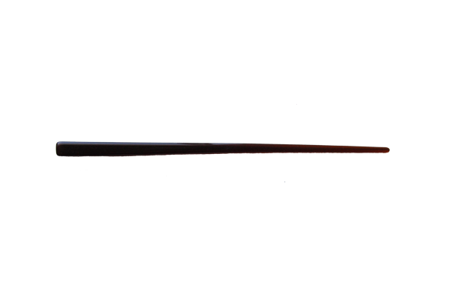

Dining-Philosophers Problem
Shared data
Bowl of rice (data set)
semaphore chopstick [5] initialized to 1

Slide 31
Dining-Philosophers Problem Algorithm
Structure of Philosopher i:
do {
wait (chopstick[i] );
wait (chopstick[ (i + 1) % 5] );
// eat
signal (chopstick[i] );
signal (chopstick[ (i + 1) % 5] );
// think
} while (TRUE);
What is the problem with this algorithm?

Slide 32
Dining-Philosophers Problem Algorithm
Deadlock handling
Allow at most 4 philosophers to be sitting simultaneously at the table.
Allow a philosopher to pick up the chopsticks only if both are available.
Use an asymmetric solution -- an odd-numbered philosopher picks up first the left chopstick and then the right chopstick. Even-numbered philosopher picks up first the right chopstick and then the left chopstick.

Slide 33
Problems with Semaphores
Incorrect use of semaphore operations:
signal (mutex) …. wait (mutex)
wait (mutex) … wait (mutex)
Omitting of wait (mutex) or signal (mutex) (or both)
Deadlock and starvation are possible

Slide 34
Thank You

